Slide 1

Tax and Tariff Matters in the Retail Industry
Christopher Oliva
Pete Mento
Selena Schneider
November 5th, 2019

Slide 2
Legislative Update
By
Chris Oliva

Slide 3
2019 Tax Legislative Update
Congress is working toward a year-end tax package.
  Likely to be several different policy areas cobbled together.
Reports are conversations continue to be positive and fruitful, but slow in progress.
Notes:
Worth noting, House Dems feel scorned from the TCJA process, and are looking to beef up Dem priorities in exchange for technical corrections.
Also helpful to think about, if none of the specific policy areas has enough support to move on its own otherwise would have happened already. These policy areas need to be grouped together in some balanced way to attract enough votes to survive the process in both chambers (hence the slow negotiation).

Slide 4
TCJA Technical Corrections
A technical corrections bill would fix errors in the 2017 tax law. Lawmakers have introduced bills to fix some high-profile errors, but there isn’t yet a comprehensive package.
  H.R. 1869, S. 803, The bill would correct the “retail glitch,” which prevents restaurants and retailers from immediately writing off the cost of interior improvements.
House and Senate: Fixing some errors, such as the “retail glitch,” has bipartisan support.
  Other fixes might happen if the Republicans agree to some Democratic priorities such as expanding the earned income tax credit or the child tax credit.

Slide 5
Tax Extenders
H.R. 3301, S. 617
  The measures would extend various tax breaks targeted to industries and individuals on a temporary basis. The expired tax breaks include perks for biodiesel, rail, and other industries.
House: The Ways and Means Committee approved H.R. 3301 by a vote of 25-17 on June 20.
Senate: The Finance Committee may hold a hearing or markup regarding extenders in the fall.
Work Opportunity Tax Credit (WOTC) – set to expire after December 31, 2019
  Planning for “retroactive” reinstatement of Credit is required
  Discuss with 3rd party provider (ADP or other payroll provider) the plan to continue to request/receive necessary information.
Many extenders have bipartisan support and could be attached to funding legislation this fall. But several have also lapsed for close to two years without renewal, and major tax provisions packaged with them in the past have been made permanent, calling into question whether there is as much support to pass them.
Notes:
It is debatable that the Extenders package could be included in any funding legislation this year. Leadership may not wish to cloud the issue further, as they are already negotiating other hot-button issues in that space (i.e. immigration/border wall).

Slide 6
Qualified Improvement Property and Final Regulations on Bonus Depreciation

Slide 7
Depreciation and Cost Recovery
Bonus Depreciation
100% bonus depreciation for assets acquired pursuant to a written binding contract entered into from September 28, 2017 through December 31, 2022
Allows for bonus depreciation on used property
Phases out bonus depreciation from 2023 through 2027

Slide 8
Depreciation and cost recovery – Qualified improvement property
Before tax reform, improvements to real property classified as qualified leasehold improvements, qualified retail improvements, and qualified restaurant property had a 15-year recovery period and were eligible for 50% bonus depreciation
The conference committee report indicated that Congress intended to combine the three types of property into a new category of real estate improvements called qualified improvement property (QIP) that would be eligible for a 15-year life and bonus depreciation. QIP includes certain improvements to an interior portion of a building that is nonresidential real property.
However, due to an apparent drafting error, the statute did not extend the eligibility of QIP beyond Dec. 31, 2017
While many had hoped that the regulations would grant QIP eligibility for 100% bonus depreciation, this was not the case
Technical correction bills (bipartisan support) have been introduced – Current political climate is roadblock to passage

Slide 9
Final Regulations – Bonus Depreciation (IRC Sec. 168(k))
Final Regulations issued September 13, 2019
  Proposed Regulations issued on August 8, 2018 were adopted
  Qualified Improvement Property “glitch” NOT fixed
Bonus Depreciation – 100% (full expensing)
Self-constructed property issues were addressed
    Pre-tax reform regulations provided rules for “self constructed property”:
      Acquisition date rule – written binding contract would be met if taxpayer began construction after the applicable effective date.
      Construction began when physical work of a “significant nature” had begun (i.e., 10% of total cost was paid or incurred).
    Proposed Regulations provided:
      Eliminated Pre-tax reform rules related to “self-constructed property” constructed on behalf of the taxpayer by 3rd party
      As a result, ALL “self constructed property” constructed by 3rd party under written contracted entered into before September 28, 2017 would be ineligible for 100% bonus depreciation.
    Final Regulations provided:
      Reinstated “Pre-tax reform” rules

Slide 10
Final Regulations – Bonus Depreciation (IRC Sec. 168(k))
Amended Tax Return/Change in Accounting Method Possibilities
  Many taxpayers filed their tax returns prior to Final Regulations being released on September 13, 2019
  Taxpayers that would have benefited from the change in Final Regulations have two options:
    File an Amended tax return for 2018
    File an accounting method change for the change in bonus depreciation rate with their 2019 tax return

Slide 11
Life After Wayfair – Responsible Person Impact

Slide 12
Wayfair Review
June 2018 – Supreme Court Case – South Dakota v. Wayfair, Inc.
  Sales and Use Tax - Economic Nexus – Interstate Sales
  Move away from “physical presence” towards “substantial nexus”
  Established when a taxpayer “avails itself of the substantial privilege of carrying on business” in the jurisdiction
  Threshold established is at least 200 transactions or at least $100,000 of sales in the state, on an annual basis
  Since the ruling in June 2018, the District of Columbia and all 45 states with Sales taxes have enacted or are expected to enact nexus rules similar to those in South Dakota (some with different thresholds and effective dates)
  Online Retail sales of tangible goods, digital goods and services

Slide 13
Responsible Person
Responsible Person Rules
  Sales and Use taxes are taxes collected on behalf of the purchaser, by the seller, that will ultimately be remitted to the relevant jurisdiction in satisfaction of the tax due
  Tax liability does not increase for the seller, however, the collection and remittance obligation is transferred from the customer to the seller
  All states with Sales and Use tax have rules that impose responsibility for tax liabilities on certain parties when their associated business cannot satisfy their obligations (i.e., Responsible Persons)
  Responsible Person may include (in New York for example):
    Officer/Director/Employee of a Corporation or Dissolved Corporation, Partnership or Limited Liability Company (LLC) who as such is under a duty to act for such entity IN COMPLYING WITH ANY REQUIREMENT of Sales and Use Taxes
    Any Partner/Member of a Partnership/LLC
    Personally liable in New York for Sales and Use Taxes imposed, collected or required to be collected

Slide 14
Responsible Person
    Relevant factors when determining whether a specific individual is a responsible person for New York law include:
  Actively involved in operating the business on a regular basis
  Involved in deciding which financial obligations are paid
  Involved in personnel activity (hiring/firing employees)
  Has check signing authority
  Prepares tax returns
  Is a Tax Manager/General Manager
  Is a Corporate Officer
    Significant personal liability could arise
    Every state is different, so each state needs to be considered
    Post-Wayfair environment requires immediate analysis and evaluation of historical and prospective nexus review

Slide 15
Partnership Items

Slide 16
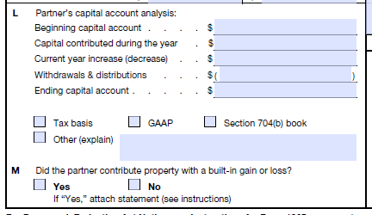
Partnership Basis Reporting
Partnerships have the option of reporting a partner’s capital account on their K-1 on a variety of methods.
IRS concerned that it does not have the appropriate tax basis information on partnerships that do not report capital accounts on a tax basis.

Slide 17
Partnership Basis Reporting
The 2018 instructions to IRS form 1065, Schedule K-1 added a new requirement for the partnership to make additional disclosures regarding each partner’s tax basis capital if:
  The capital accounts are not reflected on a tax basis, and
  The partner’s tax basis capital at the beginning or end of the tax year is negative.
Many partnerships do not have the information necessary to identify the tax basis of each partner
The IRS indicated it would assert penalties for failure to file accurate K-1s if the basis reporting was omitted

Slide 18
Partnership Basis Reporting
Penalty relief was provided by the IRS in Notice 2019-20. Penalty relief available if:
  The partner Schedules K-1 were timely filed, including extensions, and furnished to the partners containing all other required information.
  The negative tax basis information must be provided to the IRS within 180 days of the extended due date of the partnership’s return (March 15, 2020 for calendar year taxpayers).

Slide 19
Section 1202 Qualified Small Business Stock

Slide 20
Qualified Small Business Stock - Introduction
Changes made by the Tax Cuts and Jobs Act (TCJA) have caused businesses to reevaluate their choice of entity structure.
  The reduction of the corporate tax rate from 35 percent maximum to a flat 21 percent have caused some to consider whether a C corporation structure versus a flow-through structure (e.g., S corporation or partnership) may be preferred.
  In addition to considering the competing benefits of lower corporate tax rate to the new Section 199A deduction for 20% of business income, Section 1202 should be considered as well.
    Note, Section 1045 may also be available as it allows a non-corporate shareholder to defer gain on the sale of Section 1202 stock held for more than six months.
  When it applies, Section 1202, coupled with the reduction in the corporate tax rate may result in significant tax savings.

Slide 21
Qualified Small Business Stock - Requirements
  Under Section 1202, gain from the sale of qualified small business stock (QSBS) is eligible for exclusion from income. To meet the definition of QSBS, certain requirements must be met at the time of the stock's issuance, while others must be met during substantially all of the shareholder's holding period of the stock.
  Requirements for QSBS
  C corporation:
    On the date of issuance, the issuing corporation must be a domestic C corporation, and the stock must be issued after Aug. 9, 1993.
        If appreciated property is transferred to a corporation in exchange for stock, the shareholder will have a basis in the stock not less than fair market value solely for purposes of Section 1202.

Slide 22
Qualified Small Business Stock - Requirements
  Qualified small business:
    At all times from Aug. 9, 1993, through the date of issuance, the aggregate gross assets of the corporation (or any predecessor) must not have exceeded $50 million.
    Immediately after the date of issuance, the aggregate gross assets of the corporation must not exceed $50 million.
  Original issuance
    Stock must be acquired directly from the issuing corporation in exchange for money or other property (not including stock) or as compensation for services provided to the corporation (other than services performed as an underwriter).

Slide 23
Qualified Small Business Stock - Requirements
  Active business
    During substantially all of the shareholder’s holding period, at least 80 percent of the corporation’s assets must have been used in the active conduct of a qualified trade or business.
      Neither Section 1202, the underlying regulations, IRS guidance or case law define the term "substantially all." Potentially consider the “substantially all” guidance under Section 368(a)(1)(C).
  Qualified trade or business
    For substantially all of the shareholder's holding period, at least 80% of the assets of the corporation must be used in the active conduct of one or more "qualified trades or businesses.”
      Section 1202(e)(3) excludes certain businesses, including ones where the principal asset is the reputation or skill of one or more employees, banking/finance, farming, mining/oil, hotel and restaurants.

Slide 24
QSB Stock – Gain Exclusion
Gain eligible for the exclusion (“eligible gain”) is limited to the greater of
  $10 million (reduced by eligible gain taken into account during prior years) and
  10 times the taxpayer’s aggregate adjusted basis of the QSBS sold during the taxable year.
The exclusion is available only for non-corporate shareholders that acquired the stock after August 10, 1993, and have owned the QSBS for more than five years.

Slide 25
QSB Stock – Gain Exclusion
The percentage of eligible gain excluded by Section 1202 depends on when the shareholder acquired the QSBS.
  For QSBS acquired before September 27, 2010, the exclusion is either 75 percent or 50 percent.
  For QSBS acquired on or before September 27, 2010, the exclusion is 100 percent.
  For QSBS acquired before Sept. 28, 2010, 50% of gain excluded under Section 1202 is included in Alternative Minimum Taxable Income, but not for QSBS acquired after that date.

Slide 26
QSBS – Conversion of Existing Business
Companies currently operating as partnerships for tax purposes can become C corporations by, for example, electing corporate status, converting under state law, or transferring their assets to a newly organized corporation.
  Shareholders of existing S corporations cannot qualify for Section 1202 by simply revoking the corporation’s S election because only stock that is QSBS when original issued qualifies.
  However, shareholders of existing S corporations may qualify for the benefits of Section 1202 by, for example, causing the S corporation to transfer its assets to a domestic C corporation in a Section 351 exchange.

Slide 27
QSBS – Conversion of Existing Business
Companies currently operating as partnerships for tax purposes can become C corporations by, for example, electing corporate status, converting under state law, or transferring their assets to a newly organized corporation.
  Shareholders of existing S corporations cannot qualify for Section 1202 by simply revoking the corporation’s S election because only stock that is QSBS when original issued qualifies.
  However, shareholders of existing S corporations may qualify for the benefits of Section 1202 by, for example, causing the S corporation to transfer its assets to a domestic C corporation in a Section 351 exchange.

Slide 28
QSBS – Final Thoughts
Prospective purchasers of such entities, including private equity funds, should also consider Section 1202 when evaluating targets and structuring acquisitions.
  Purchasers will not receive a cost basis in the assets of an acquired C corporation (or an immediate deduction for purchased assets).
  If QSBS is being purchased, consider (1) incorporating into due diligence procedures and (2) obtaining tax representations from the seller.
  Not all states may conform to federal Section 1202 rules.
Best practices include contemporaneous documentation of satisfaction of $50 million valuation threshold along with all other items regarding Section 1202 qualification at the time the investment is made.

Slide 29
Global Trade Compliance
By
Pete Mento

Slide 30
Global Trade Compliance
For information please contact Pete Mento
Pete.Mento@crowe.com
Office: 202-779-9907
Mobile: 978-317-3250

Slide 31
Global Trade Solutions
By
Selena Schneider

Slide 32
What is Your Exposure
Assess
Strategize
Execute
Optimize

Slide 33
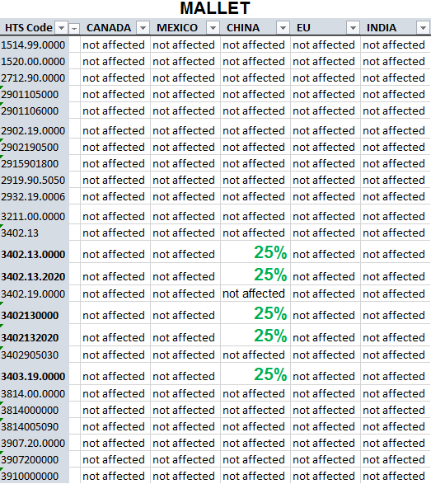
1. Assess
First, understand where and to what extent your supply chain is affected – countries, suppliers, items, product margins, and strategic options.
Understand scale of impact:
  Retrieve and analyze harmonized tariff schedule (HTS) codes imports against Tariff
  Correlate regions of focus and commodities affected back to your organization’s supply chain
  Document potential impact on margin and other risks
  Complete a deep-dive review into areas of greatest risk and financial impact
Example: Leading provider of specialty chemicals focused on personal care, food, consumer, and industrial end markets.
Issue: Realizing significant impacts due to Chinese imports
Assess impact on new legislation revisions on organization
Notes:
$300k impact to margin
Went back to have a negotiation with the distributor to offset some of the costs
Pricing strategy with end customer
Wait until legislation resolved and USMCA
-Wi

Slide 34
2. Strategize
Narrow your strategy to address areas of greatest exposure to ensure impact is minimized.
Timelines to react are tight and timelines to implement supply base change can be long. It is critical that you narrow your focus to areas of the greatest impact
What are the areas of greatest risk and impact?
  What strategies can be leveraged to address them?
    Optimize HTS class and/or apply for exemptions
    Move supply source to other best cost country and bring manufacturing in-house. For multinational corporations, work with transfer pricing professionals to optimize the best strategy for setting up the correct pricing strategy.
    Re-engineer, value analysis, and value engineering
    Customer segmentation and pricing strategy
    Use multiple sources to mitigate market volatility
Devise a strategy; prepare a plan; identify resources and governance needed
Example: Fast growing home furnishings manufacturer importing majority of raw materials for further processing
Issue: Entire supply chain based out of China with no secondary sources. Client has little experience in supplier development in new regions
Considerations:
Inquire with the Department of Commerce and Office of the U.S. Trade Representative for China products about the process to request that specific products be excluded from the tariff.
Import goods unfinished (classification concept)
Change country of origin
First Sale Valuation – Importers pay duty on the price that a trading company pays the manufacturer instead of the higher price the importer pays the trading company. Various criteria must be met to ensure that the first sale reflects a sale that is destined to the U.S. and conducted at arm’s length.
Notes:
One Example: Single sourced- Asia based supply chain
Each take one that is most relevant to services

Slide 35
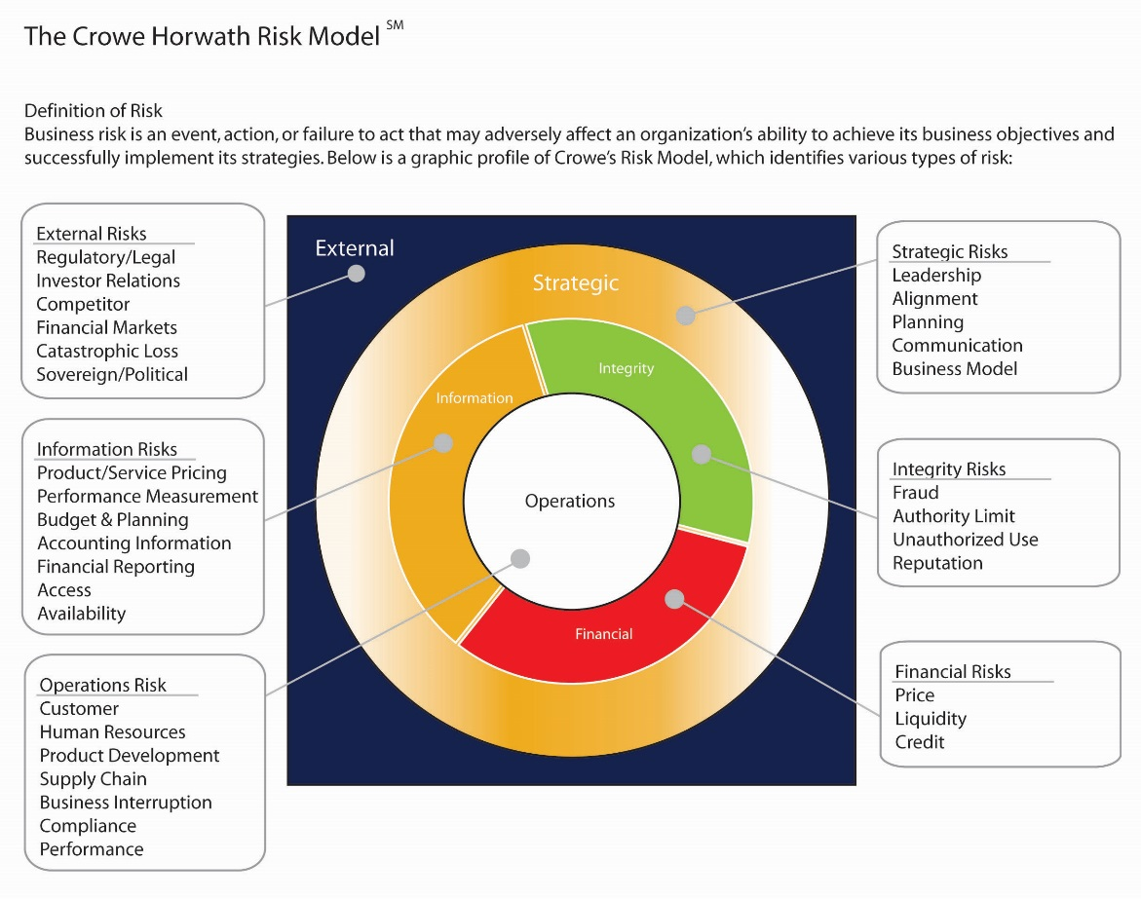
What Could Go Wrong?
Visibility within the supply chain
Communication within/out of the organization
Ongoing monitoring and feedback
Notes:
Visibility within the supply chain – did you identify all the critical products/points impacted? Other second tier supplies that could impact the costs that you are not aware of or visibility too? Discuss example of client that has experienced issues within the supply chain deriving from a second tier supplier which caused a disruption in the supply chain because the client was not aware issues with that supplier.
Communication – this is a change in the organization potentially so how do you communicate the change within the company as to the potential change or approach or activities they must adhere too. Also what is the plan to monitor communicate going forward to be proactive in the future to potential tariff or regulatory changes. Sourcing expectations to suppliers or transparency from suppliers.
What is the ongoing processes and feedback loops – who is responsible for this, what is expected to be communicated, and how often. How is the utilized to define changes to the strategy and processes. Monitoring of control functions to validate information and also capture relevant information that support further understanding of tariff issues and also for reporting of these costs and payments.
Crowe’s risk framework can help evaluate potential risks and where they reside either within your control or not in your controls and then how to address.

Slide 36
3. Execute
Execute a managed approach to driving action
The resulting strategy will be multifaceted and must be center-led to verify solutions are effective, risk is managed, and roadblocks are addressed quickly
Implement the strategy
  Develop mitigations for key strategy risks
  Develop mitigation processes/controls for relevant “what if scenarios”
  Align the organization to support change management
  Drive the “heavy lifting” required while managing unintended impacts
  Implement processes and metrics to sustain benefits

Slide 37

4. Optimize
Revisit areas of impact that were not the immediate priority to drive further supply improvement.
As you executed your strategies, it is likely that you uncovered opportunities to further optimize. Now is the time to drive action to achieve the next level of benefit.
Continuous improvement:
  Address “round two” areas where the impact is material
  Put a plan in place to execute on future improvement opportunities
Enhance approach to identify/assess potential what could wrong to increase resiliency and responsiveness to disruption events:
  What if tariff issues impact other regions of the world
  Development of common approach to identify and assess
  Clear ownership of the mitigation plans
  Not a support process but a clear element of forward strategy

Slide 38
Christopher Oliva
Christopher.Oliva@crowe.com
Office: 646-965-5724
Mobile: 516-864-1059
Pete Mento
Pete.Mento@crowe.com
Office: 202-779-9907
Mobile: 978-317-3250
Selena Schneider
Selena.Schneider@crowe.com
Office: 646-231-7207
Mobile: 973-634-5882

